Slide 1
Capstone Project – 3
credit card default prediction pradyumna vikram singh

Slide 2
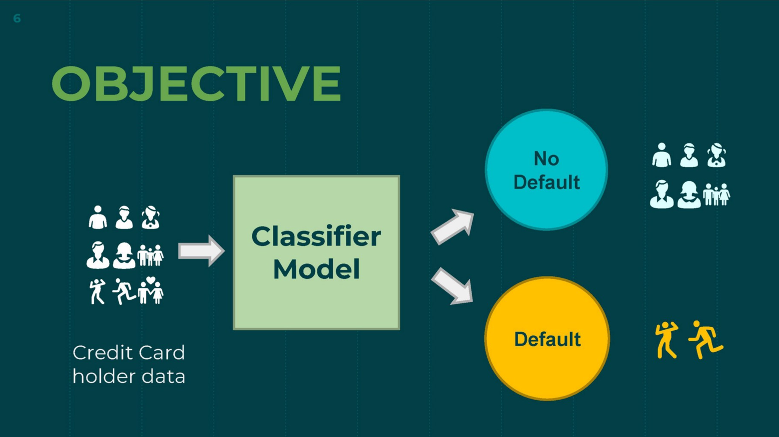
Content
Introduction
Defining Problem Statement
Data Summary
Dependency
EDA /dataset preperation
Modelling Overview
Model evaluation
Challenges
Conclusion
Q&A

Slide 3
Introduction
This dataset contains information on default payments, demographic factors, credit data, history of payment, and bill statements of credit card clients in Taiwan from April 2005 to September 2005.
This project is aimed at predicting the case of customers default payments in Taiwan. From the perspective of risk management, the result of predictive accuracy of the estimated probability of default will be more valuable than the binary result of classification - credible or not credible clients.

Slide 4

Defining Problem Statement
Identify the key drivers that determine the likelihood of credit card default.
Predict the likelihood of credit card default for customers of the Bank.

Slide 5
Data Summary
X1 - Amount of credit(includes individual as well as family credit)
X2 - Gender
X3 - Education
X4 - Marital Status
X5 – Age
X6 to X11 - History of past payments from April to September
X12 to X17 - Amount of bill statement from April to September
X18 to X23 - Amount of previous payment from April to September
Y - Default payment

Slide 6

Approach Overview
Data inspection and cleaning
Exploring data, checking for outliers
Clean data to get it ready for Analysis
EDA & Data Pre-processing
Checking distributions of variable
Univariate and multivariate analysis
Checking for imbalanced dataset
Modelling (Implementing Machine Learning Algorithms)
Logistic
KNN
Random Forest +Decision Tree
XGBoost
SVM

Slide 7
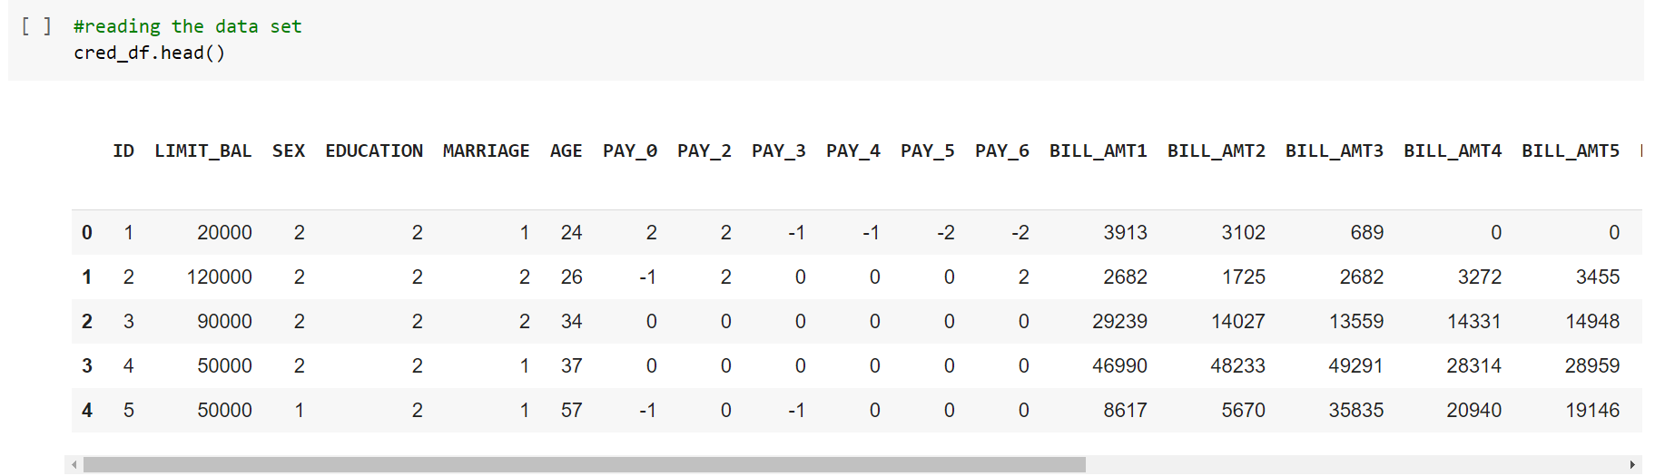
Basic Data Exploration
Taiwan from April 2005 to September 2005.
Dataset contains 30000 rows & 25 columns.
In dataset, 6 months payment and bill data available.
There are no null or duplicate values.

Slide 8
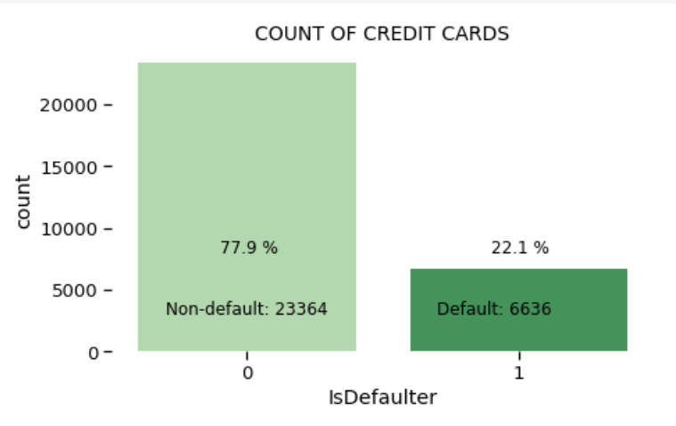
Feature Analysis - The frequency of defaults
Looking at data, we get this idea that it is a case of Imbalanced dataset.
Count of Non-default is a lot higher than default value.
Non- Default data is 77.9% while Default cases are 22.1% as in dataset.

Slide 9
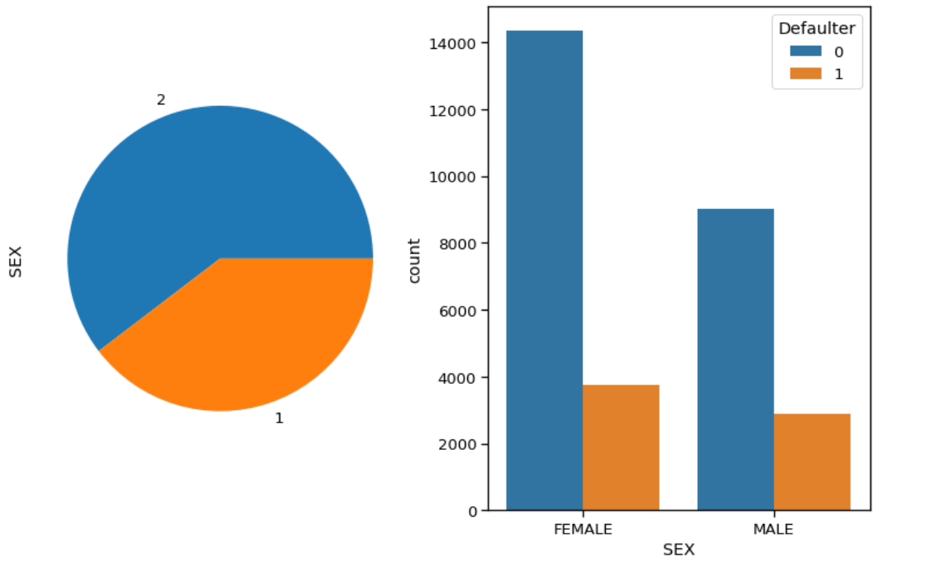
Feature Analysis - Gender wise defaulter prediction
Larger percentage of females than males in default payment category.

Slide 10
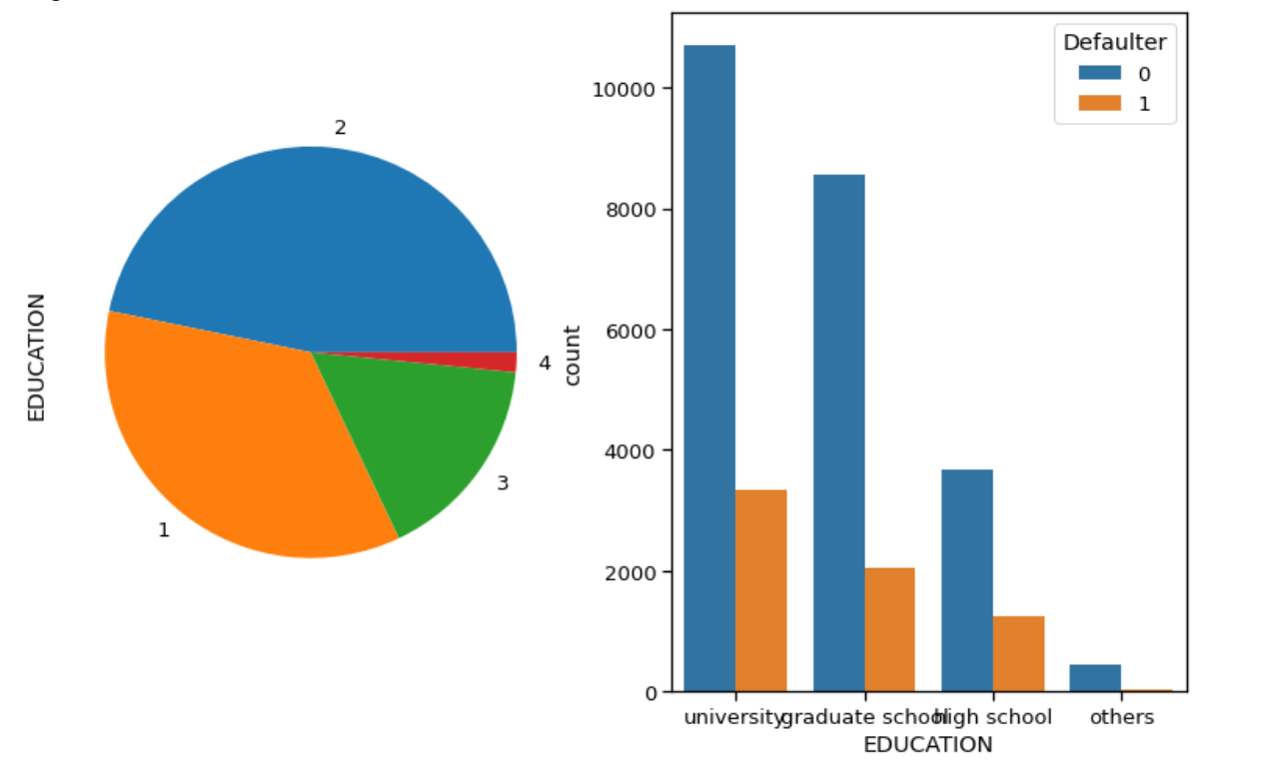
Feature Analysis - Education wise defaulter prediction
Number of defaulters have a higher possibility that the person is educated (graduated from school or university).

Slide 11
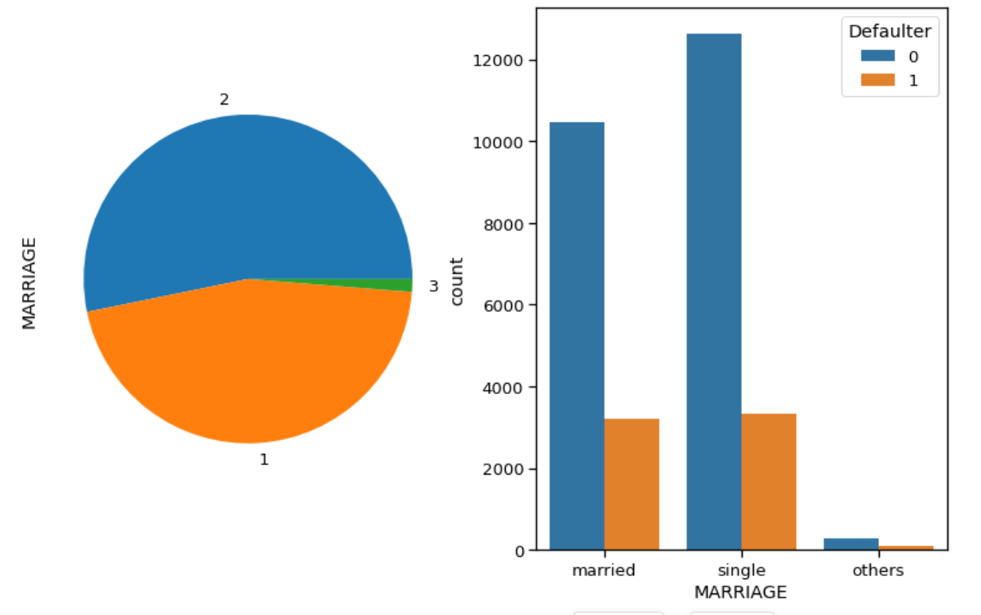
Feature Analysis – Marital status wise defaulter prediction
Individuals having single status have higher percentage of default than married.

Slide 12
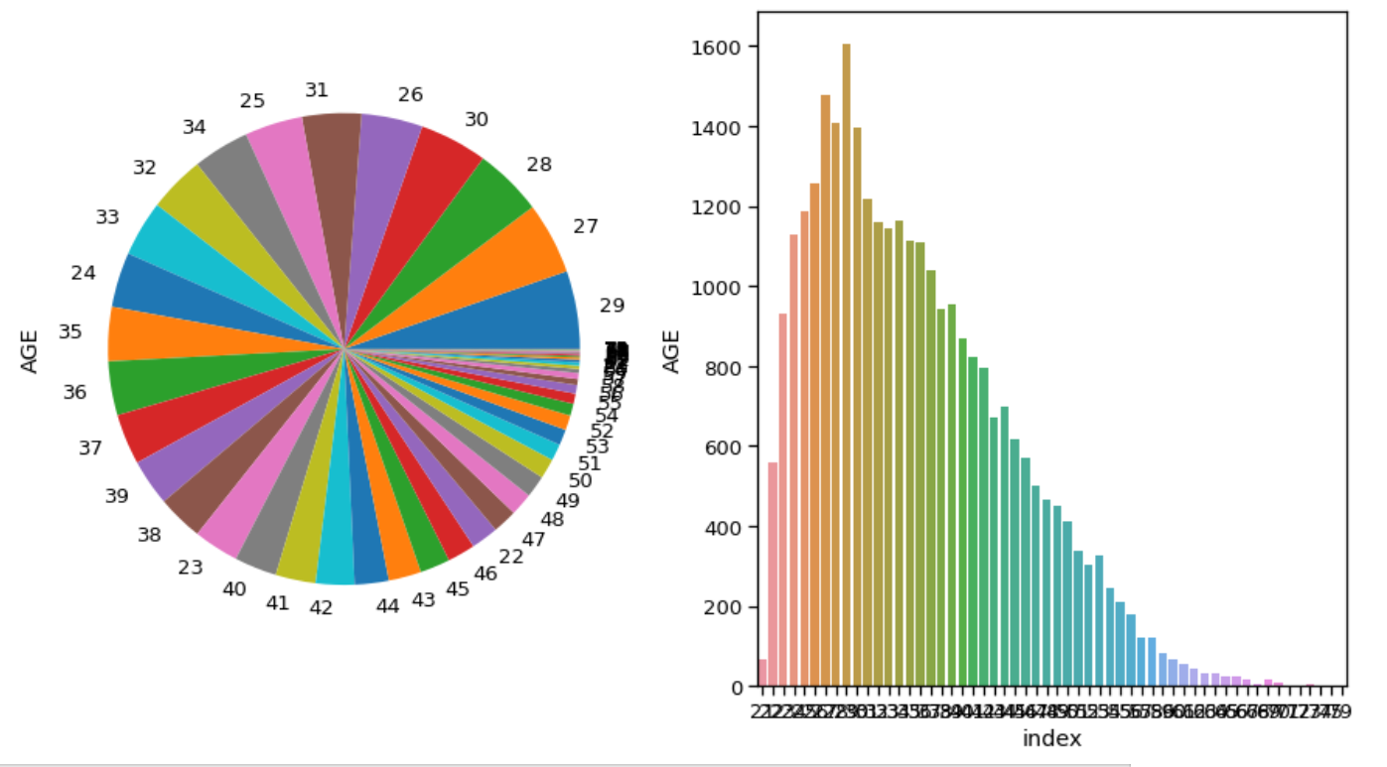
Feature Analysis – AGE wise Defaulter Prediction
Age peaks around 28-29 years in default payment category. But there is no major relation between age and defaulter prediction.

Slide 13
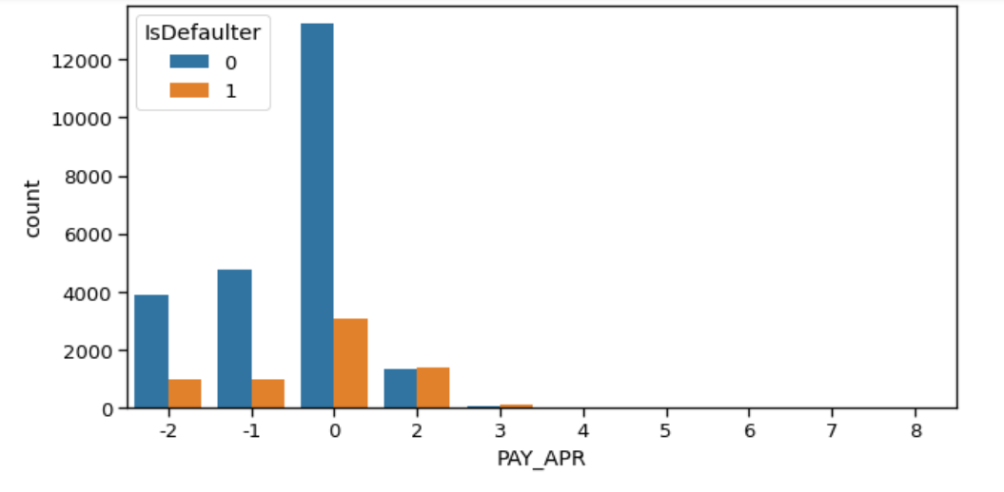
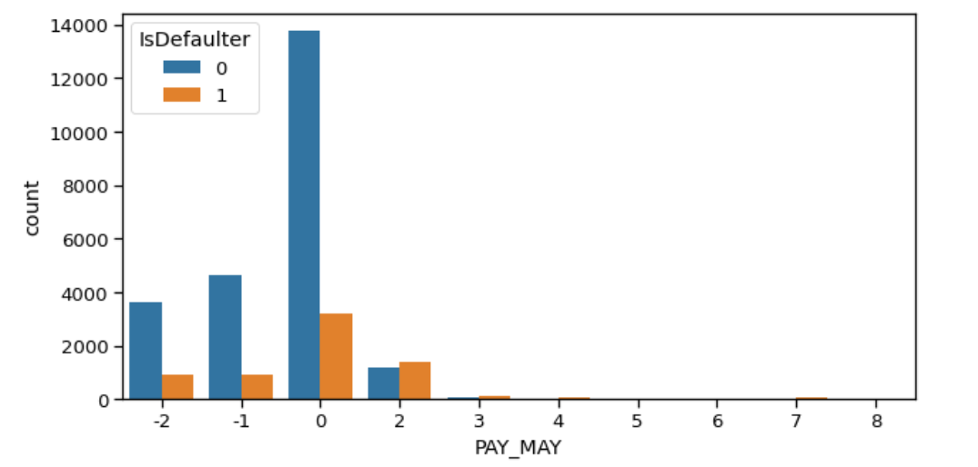
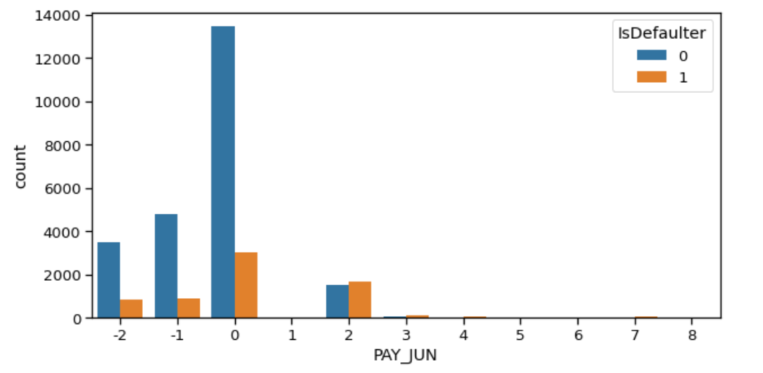
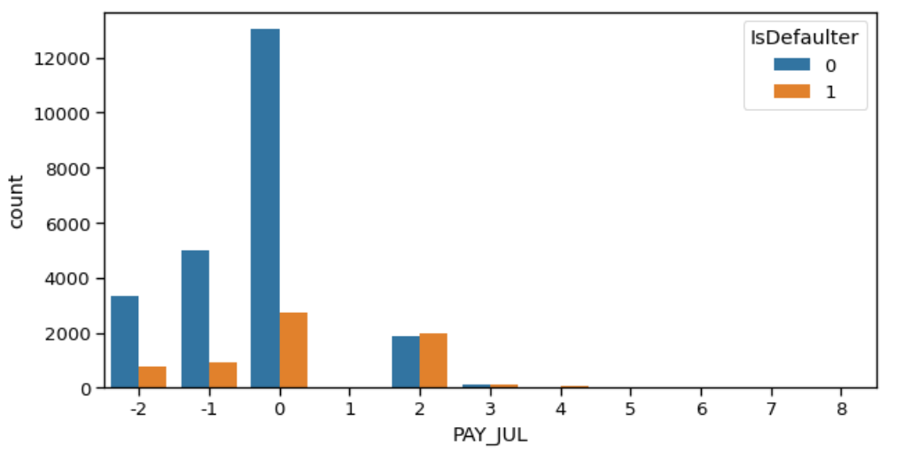
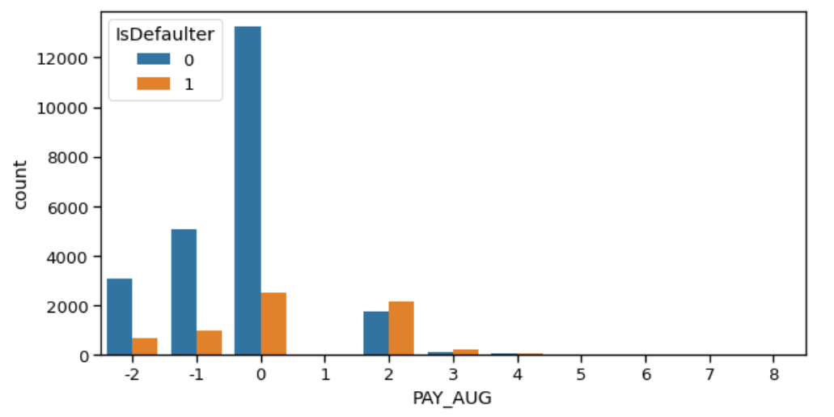
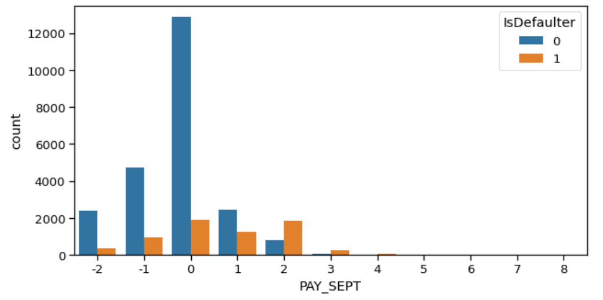
Observation on payment history
After careful observation, we found that most credit card payment by the customers were on time. We see the distribution of the plot peak at 0 value, which means that on the x scale no delay in the payment of card.

Slide 14
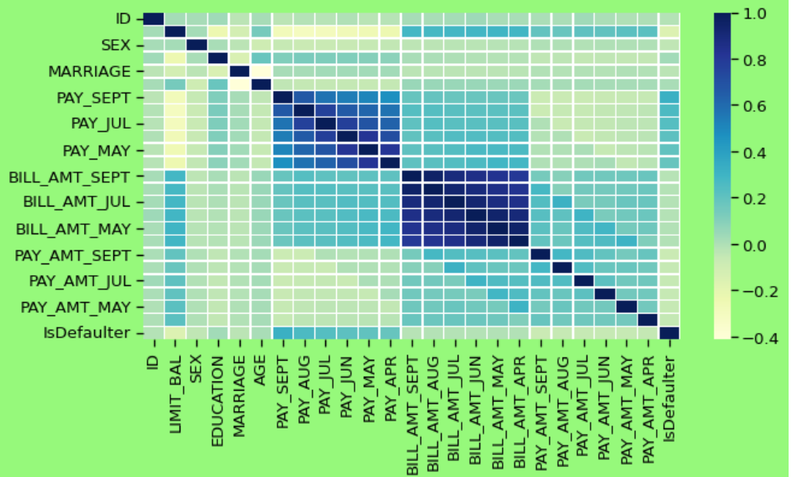
Feature Analysis - Correlation between parameters
We can see that no correlation between the features. So, no need to remove or drop some features.

Slide 15
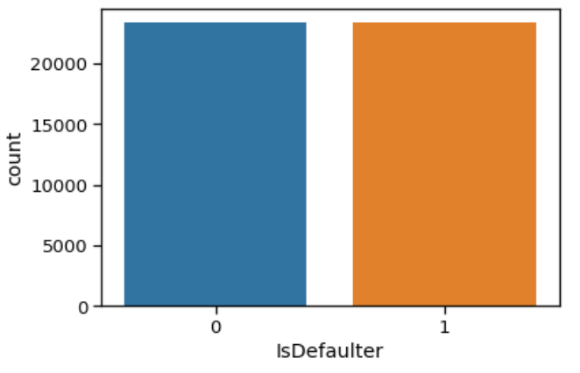
SMOTE(Synthetic Minority Oversampling Technique)
Before SMOTE After SMOTE

Slide 16
Data Pre-processing
Feature engineering
Feature selection
Train test data split (67%-33%)
SMOTE oversampling(Synthetic Minority Oversampling Technique)
Data Fitting and Tuning
Start with default model parameters
Hyperparameter tuning
Measure AUC- ROC after training data
Model Evaluation
Model testing
Precision Recall Score
Compare with the other models

Slide 17

Modeling Overview
This is Classification problem statement.
There is Imbalance data with 78% non-defaulters and 22% defaulters.
We have applied following models :
Logistic Regression
KNN
Decision Tree
Random Forest
XGBoost
SVM
Default or not default
Default or Not_default

Slide 18
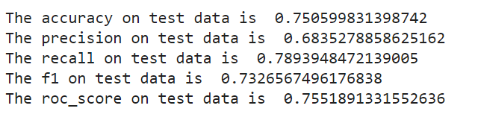
Logistic Modelling
Best parameters : C= 0.01, penalty = L2

Slide 19
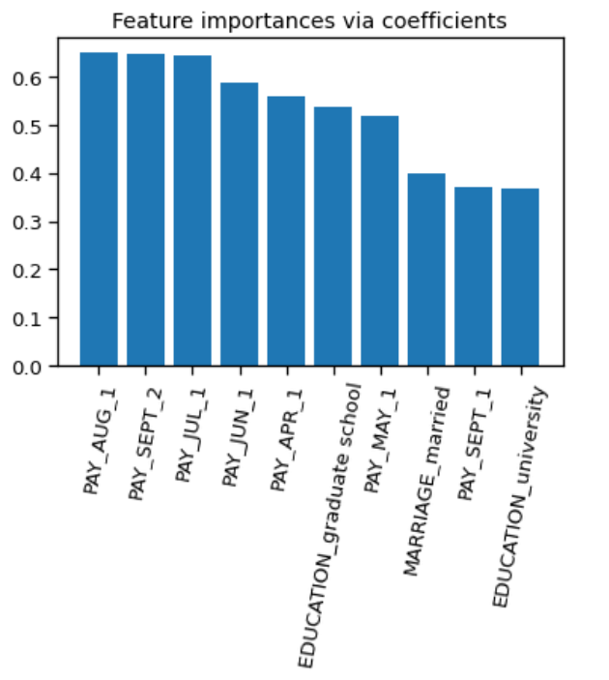
Features importance according to logistic regression
Payment-month is important feature with respect to different month’s defaulter rate.

Slide 20
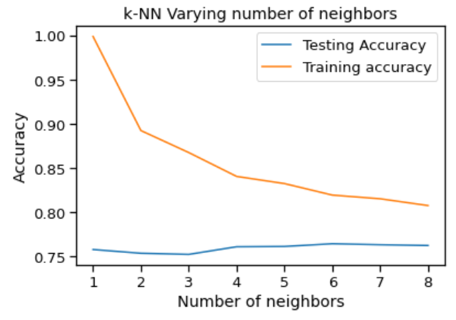
Implementing K-NN
We found that k=7 is the best nearest neighbour because the test and train accuracy meet near at this point so calculating model performance and we get AUC-ROC score around 83% after running KNN model for the data set.

Slide 21
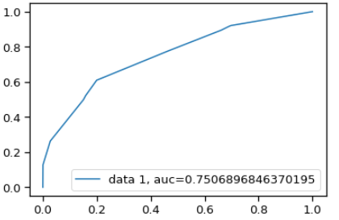
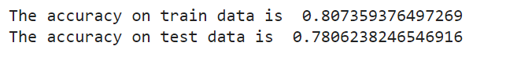
Decision Tree
Best parameters : max_depth = 20, min_samples_split = 0.1
The decision tree AUC-ROC score is 75% which not satisfactory comparison to other model score.

Slide 22
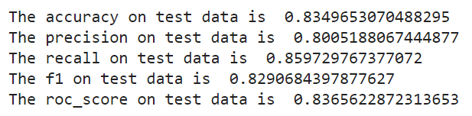
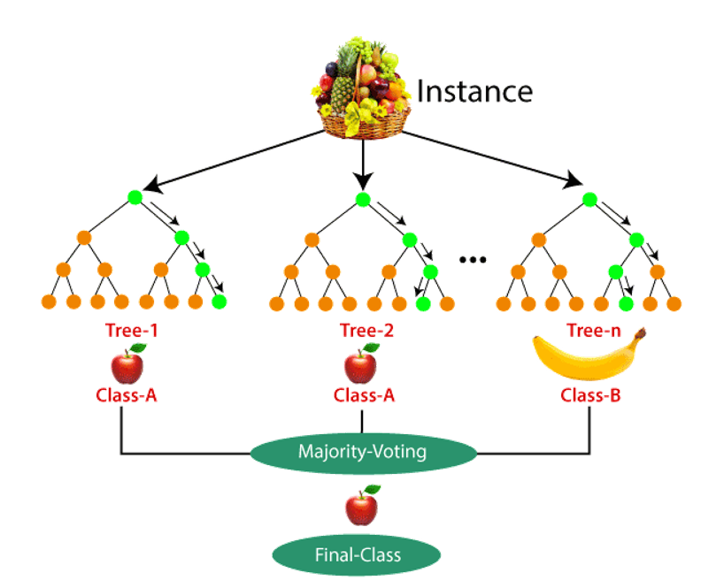
Implementing Random Forest Classifier
Best Parameters : max_depth = 30, n_estimators = 200
Random forest having approx. 92% AUC-ROC score which is high then the all model score or the best recall approx. 86%

Slide 23
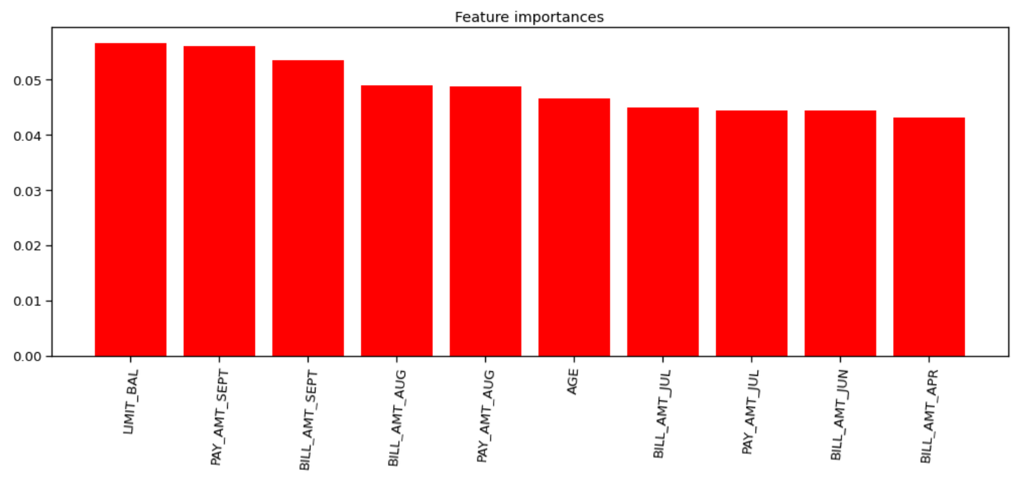
Feature Importance according to Random forest
Credit limit is the major reason of defaulter as per Rf

Slide 24
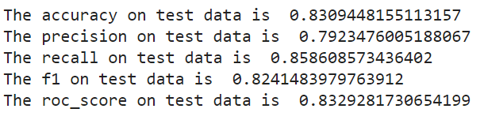
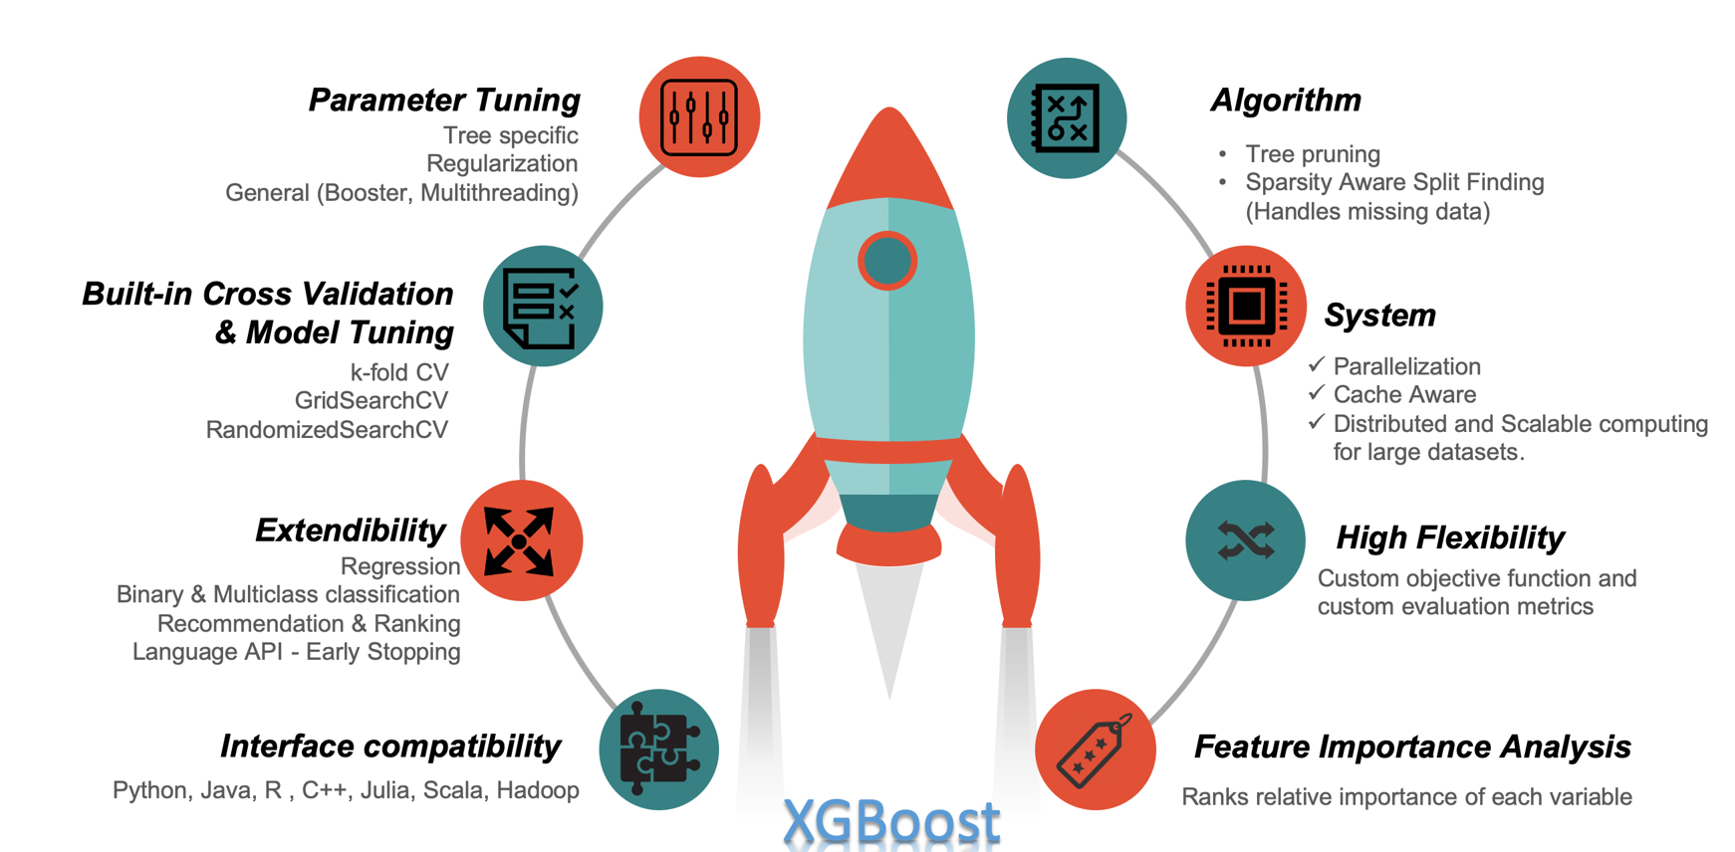
Implement the XGBoost

Slide 25
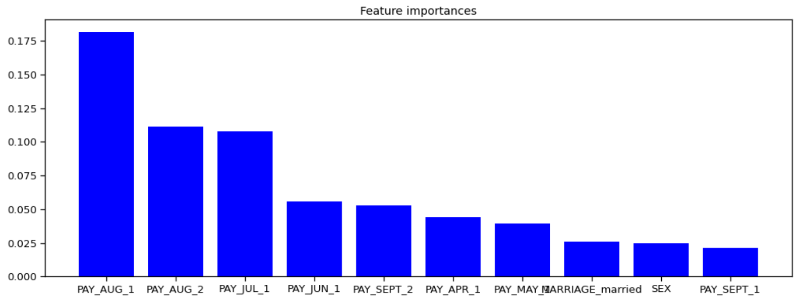
Feature importance according to XGBoost
Pay_Aug_1 is the most important feature here.

Slide 26
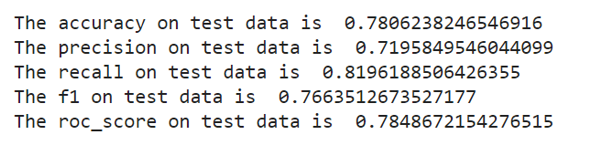
SVM (support vector machine)
Best parameters : C = 10, kernel = rbf

Slide 27
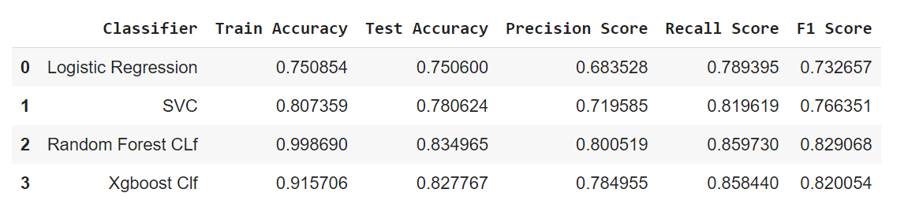
Model Evaluation
Random Forest is the winner here with highest recall score 0.85.

Slide 28
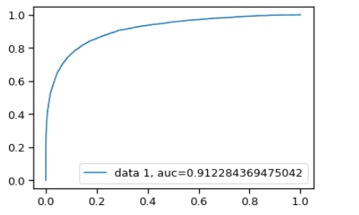
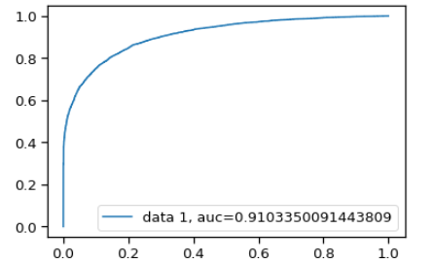
Model Evaluation
Random Forest score
XGBoost

Slide 29
Observations on basis of AUC – ROC score
Observations_1 : We started with Logistic Classifier and then with XGBoost , for which we obtained an AUC score of 0.81 and 0.91, respectively, when predicting the target for the test set. We followed with an KNN model, with a lower AUC score (0.83) for the prediction of the test set target value. We then followed with a SVM, with the AUC score after training iterations 0.85.
Observations_2 : We then experimented with an Random Forest model. In this case, we alidation of the training mused the validation set for vodel. The best AUC score obtained was 0.912.

Slide 30

Challenges
Reading the dataset and understanding the problem statement.
Designing multiple visualizations to summarize the Data points in the dataset and effectively communicating the results and insights to the reader.
Dealing with Imbalanced Dataset
Feature engineering
Feature selection - Making sure we don’t miss any important feature.
Careful tuning of hyperparameters as it affects accuracy.
Computation time was a big challenge for us.

Slide 31
Conclusion
Descriptive Analytics
In conclusion, the data exploration of credit card default dataset shows :
No Missing values were found.
Larger percentage of females than males in default payment category.
Percentage of customers having graduate/Uni school degree is higher in default payment category.
Individuals having single status have higher percentage of default than married, age peaks around 28-29 years in default payment category.
As per the data collection, the number of defaulters lies in the range of 22% usually across all predictors.

Slide 32
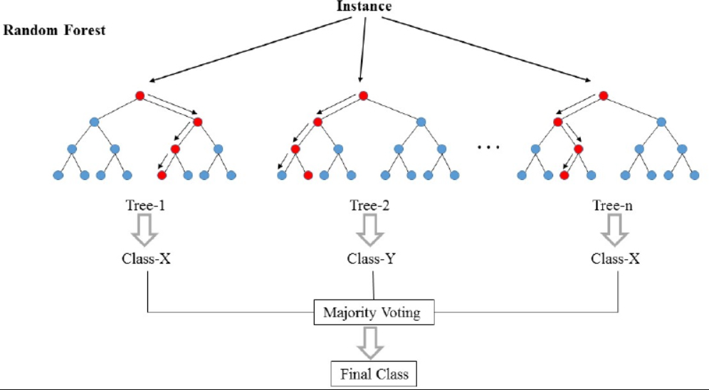
Conclusion while training model
Random Forest provided us the best results giving us a recall of 86% (It means out of 100 defaulters 86 will be correctly caught by Random Forest ).
XGBoost also had good score as well with recall of 85.8%.
Logistic regression being the least accurate with a recall of nearly 78%.

Slide 33



